Slide 1

Python: Pandas DataFrames

Slide 2
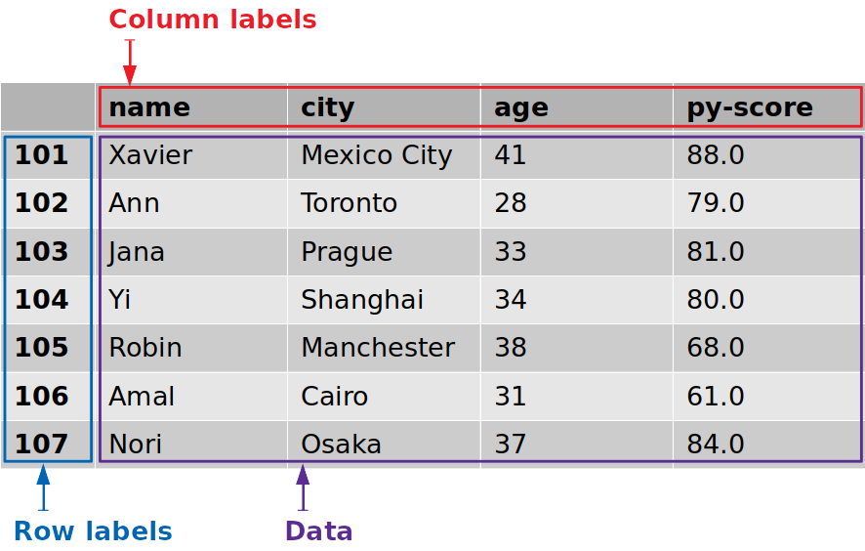
Import from Excel ➔ DataFrame
import pandas as pd
# Load excel file
data = pd.ExcelFile('example.xlsx‘)
# Print the sheet names
print(data.sheet_names)
# Load a sheet into DataFrame named: df1
df1 = data.parse('Sheet1')

Slide 3
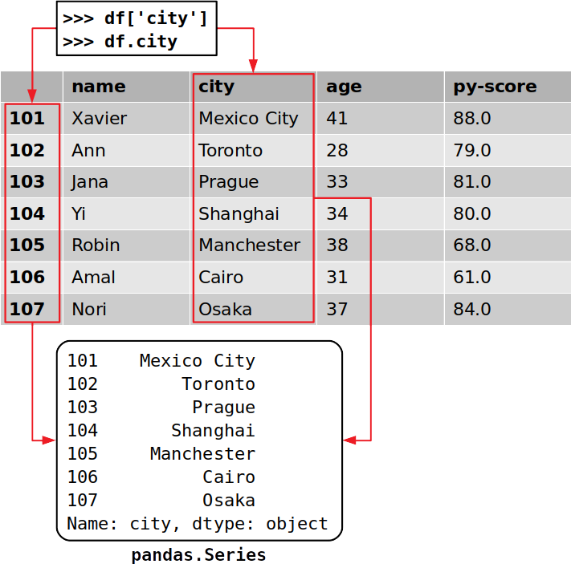
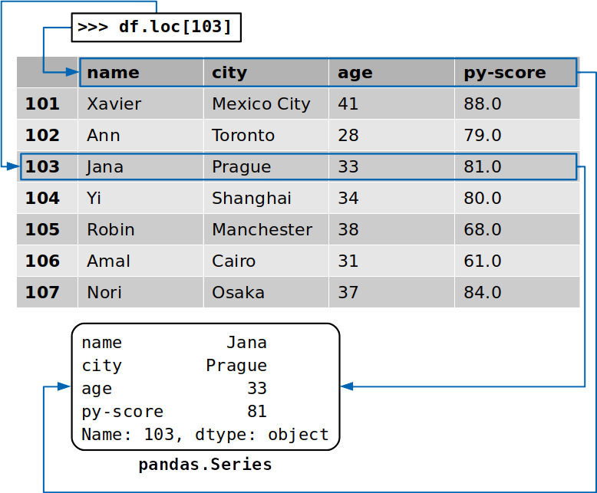
Print DataFrame

Slide 4
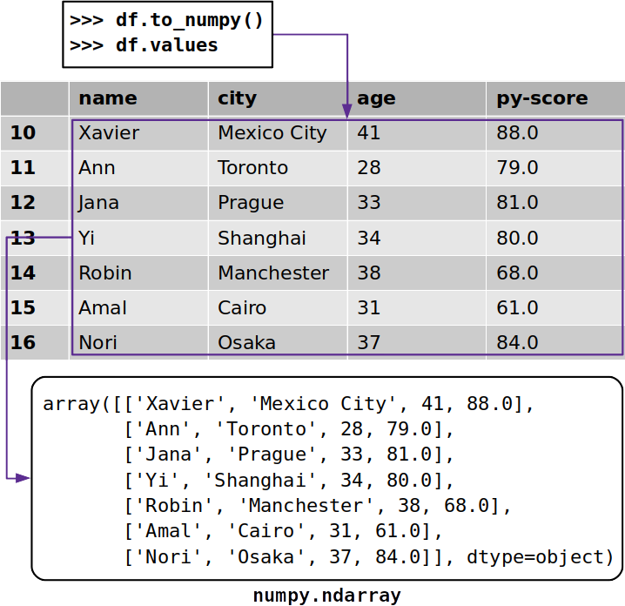
DataFrame ➔ NumPy Arrays
Sometimes you might want to extract data from a Pandas DataFrame without its labels. To get a NumPy array with the unlabeled data, you can use either .to_numpy() or .values
Both work similarly and return a NumPy array with the data from the Pandas DataFrame.

